Slide 1


Data Analysis with Power BI

Slide 2





Introduction to Power Visualizations
Lecture 2: Summary
Table, Matrix Visuals
Line, Bar charts
Creating Groups. Donut chart
Advanced Visuals
Card, Map visuals
Tree Map, Funnel Visuals
Slicers and Gauge Visual
Creating Dashboards
Interactivity of Visuals
Filters
Power BI AppSource
www.dsa.az Bütün hüquqlar qorunur.
DATA SCIENCE ACADEMY
2

Slide 3


I
Introduction to Visualizations

Slide 4
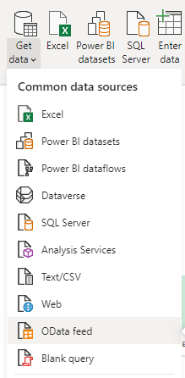
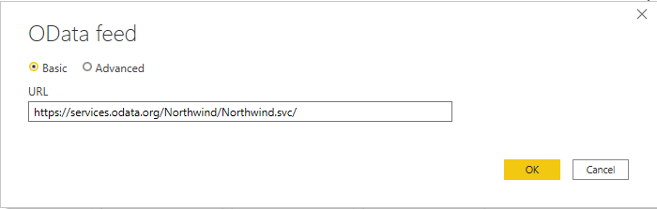
Odata Feed Source
We can import and combine several excel documents at the same time.
Select Odata Feed from Get data drop down selection from Home tab
Write the link in the proper area in new opened window
https://services.odata.org/Northwind/Northwind.svc/
Click Orders, Customers, Products, Categories from new opened Navigator window.
Click Load
www.dsa.az Bütün hüquqlar qorunur.
DATA SCIENCE ACADEMY
4

Slide 5
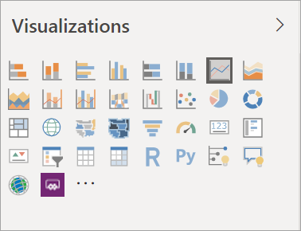
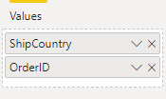
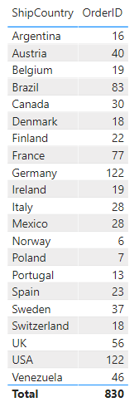
Table visual
Click once Table visual in Visualizations field.
Click Orders table once and open it.
Swipe ShipCountry and OrderID columns to the Values field.
Select OrderID from Conditional formatting field in Format window.
Click ON for Data bars part.
Customize its size with swiping its corners.
www.dsa.az Bütün hüquqlar qorunur.
DATA SCIENCE ACADEMY
5

Slide 6
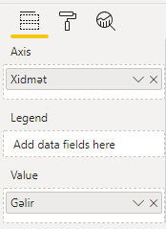
Matrix visual
Click once Matrix visual in Visualizations field.
Click Products and Categories tables and open them.
Swipe ProductID and UnirPrice columns from Products table to Rows and Values fields respectively and CategoryName column from Categories table to the Columns field.
Select UnitPrice from Conditional formatting field in Format window.
Click ON for Data bars part.
Customize its size with swiping its corners.
www.dsa.az Bütün hüquqlar qorunur.
DATA SCIENCE ACADEMY
6

Slide 7
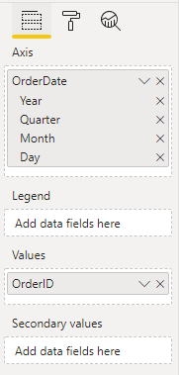
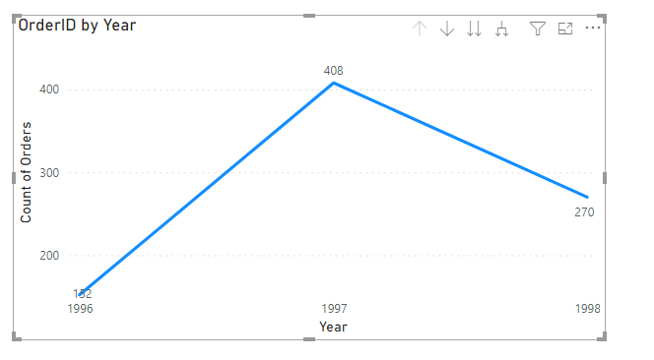
Line Chart
Click once Line Chart visual in Visualizations field.
Click Orders table and open it.
Swipe OrderDate and OrderID columns from Orders table to Axis and Values fields respectively.
Name X and Y axis properly from format tab
Click ON for Data labels part.
Customize its size with swiping its corners.
www.dsa.az Bütün hüquqlar qorunur.
DATA SCIENCE ACADEMY
7

Slide 8
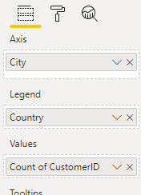
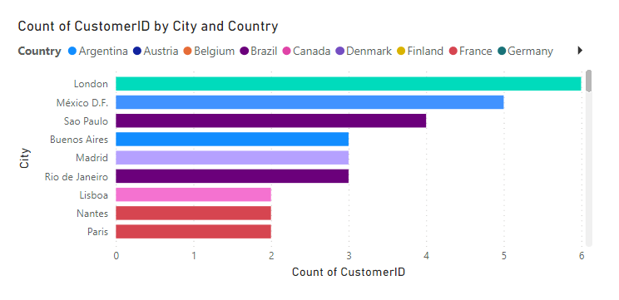
Bar Chart
Click once Stacked Bar Chart visual in Visualizations field.
Click Customers table and open it.
Swipe City, Country and CustomerID columns from Orders table to Axis, Legend and Values fields respectively.
Customize its size with swiping its corners.
If we click any bar from bar chart (or any other visual) other visuals will display proper selections.
www.dsa.az Bütün hüquqlar qorunur.
DATA SCIENCE ACADEMY
8

Slide 9
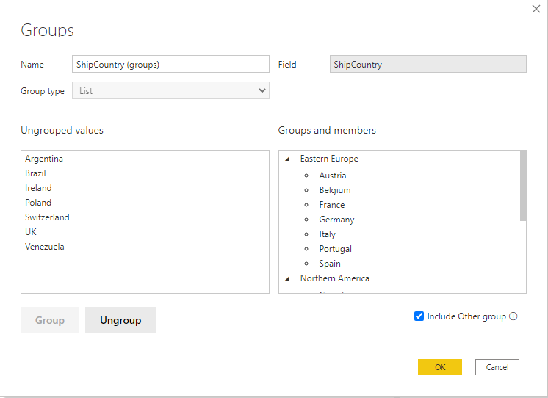
Creating Groups
Right Click on ShipCountry from Orders table in Fields part.
Click New Group.
Click ‘Canada’, ‘USA’ with ‘ctrl’ key and click Group button
Afterwards, group Latin American countries and Western European countries separately.
Click Include Other group
Name groups properly
www.dsa.az Bütün hüquqlar qorunur.
DATA SCIENCE ACADEMY
9

Slide 10
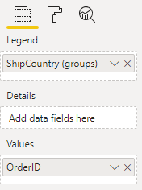
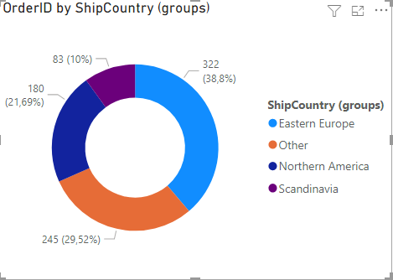
Donut Chart
Click once Donut Chart visual in Visualisations field.
Click Orders table and open it.
Swipe ShipCountry (groups) and OrderID columns from Orders table to Legend and Values fields respectively.
Write “Orders over Countries” in Title text field from Title.
Customize its size with swiping its corners.
Donut Chart and Pie Chart are used for the same purpose.
www.dsa.az Bütün hüquqlar qorunur.
DATA SCIENCE ACADEMY
10

Slide 11
II
Advanced Visuals, Slicers

Slide 12
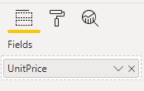
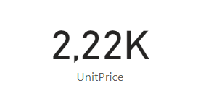
Card visual
Click once Card visual in Visualizations field.
Click Products table and open it.
Swipe UnitPrice column from Products table to Fields part.
Power BI Card visual displays sum of proper columns in first sight, although it can be chosen as average, min, max and so on by right click on the proper column in Fields part.
www.dsa.az Bütün hüquqlar qorunur.
DATA SCIENCE ACADEMY
12

Slide 13
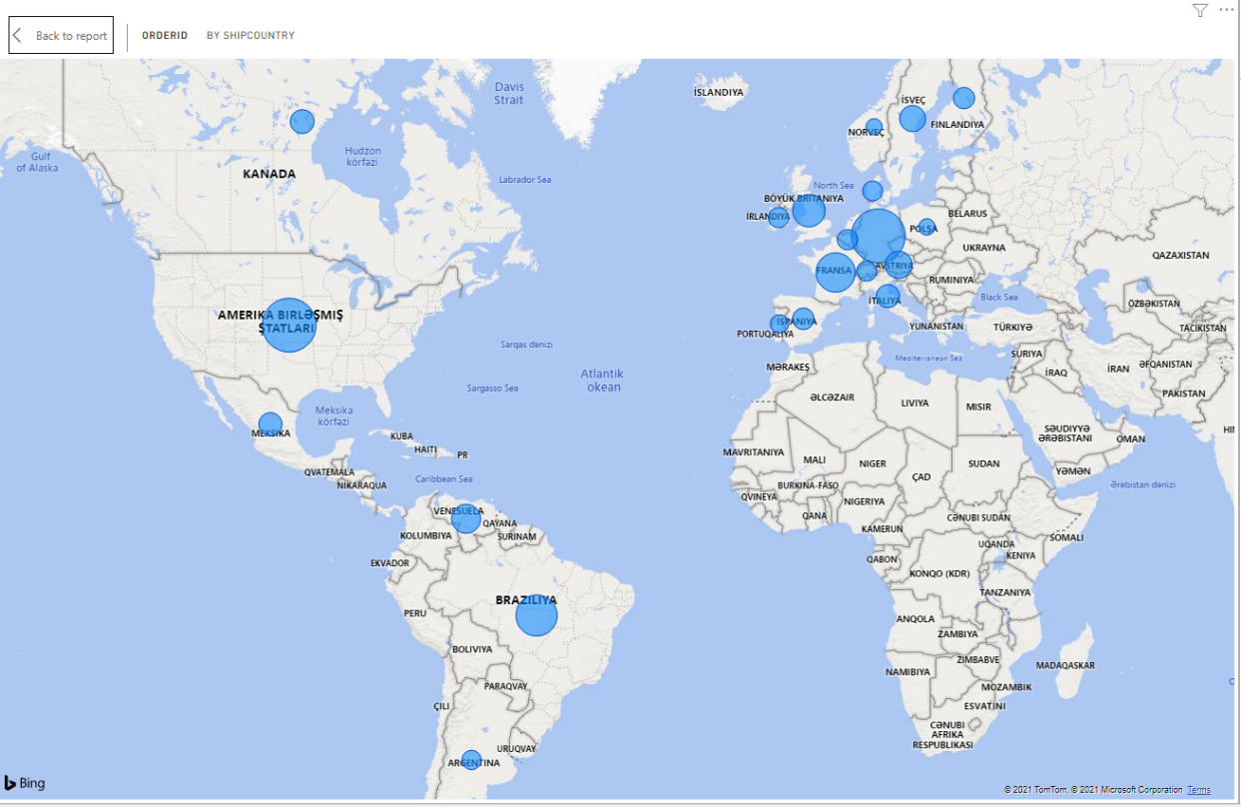
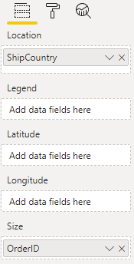
Map visual
Click once Map visual in Visualizations field.
Swipe ShipCountry and OrderID columns from Orders table to Location and Size fields respectively.
www.dsa.az Bütün hüquqlar qorunur.
DATA SCIENCE ACADEMY
13

Slide 14
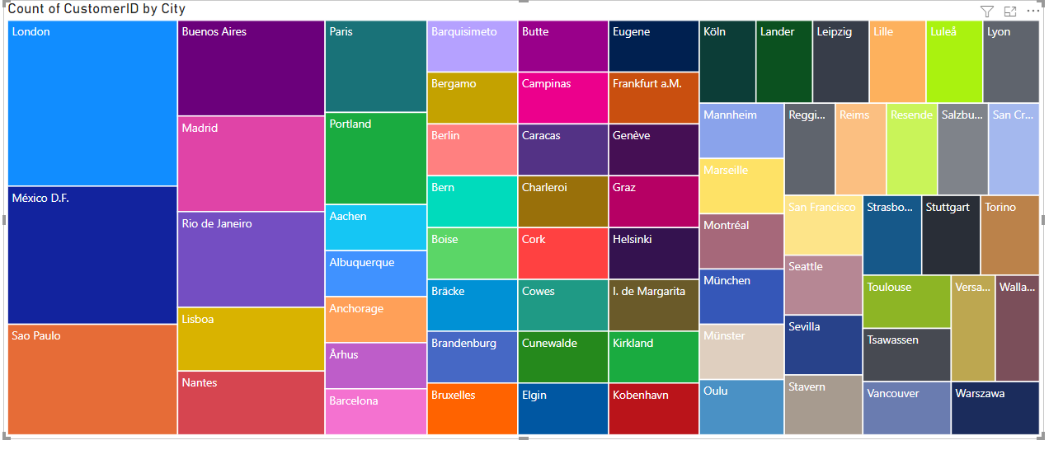
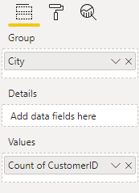
Tree map
Select Tree map Visual from Visualizations tab
Swipe Region column from Locations table to Group column area
Swipe Transaction column from Locations table to Values column area
Click Right Mouse on the TransactionID column in Visualizations tab and select Count
www.dsa.az Bütün hüquqlar qorunur.
DATA SCIENCE ACADEMY
14

Slide 15
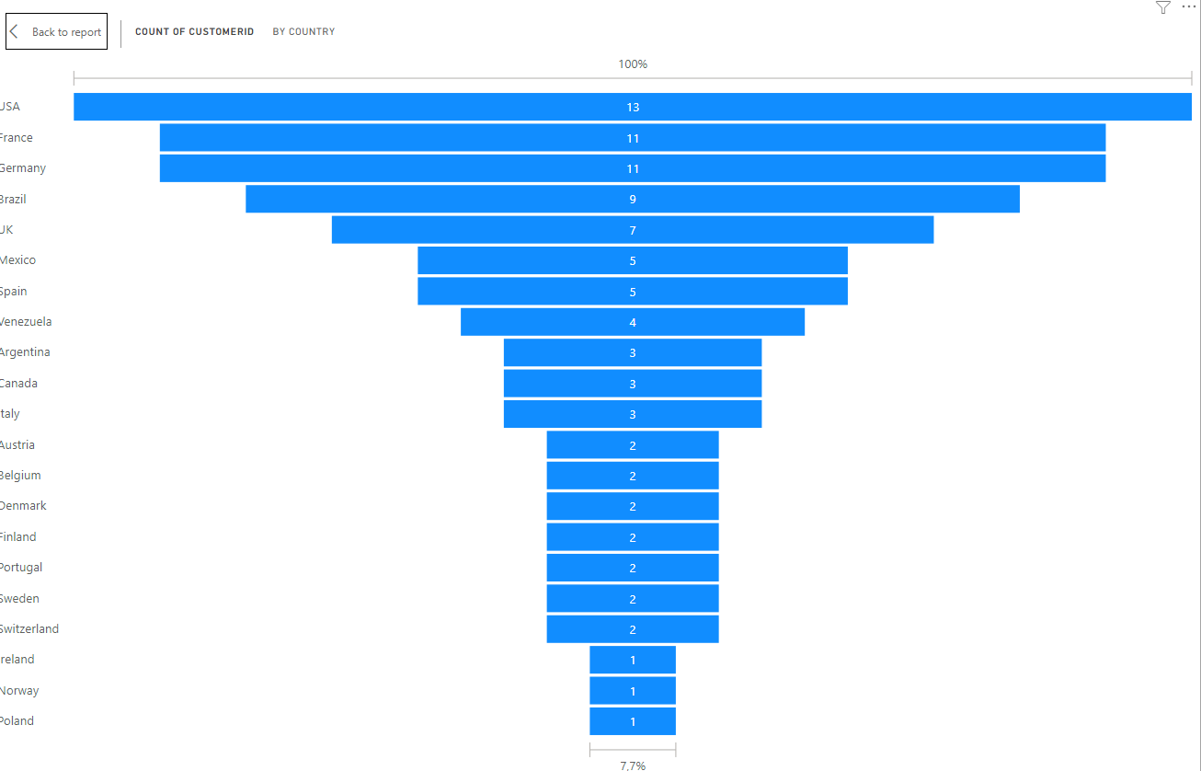
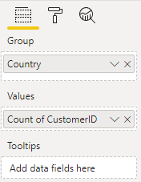
Funnel
Select Funnel Visual from Visualizations tab
Swipe Country column from Customers table to Group column area
Swipe CustomerID column from Customers table to Values column area
www.dsa.az Bütün hüquqlar qorunur.
DATA SCIENCE ACADEMY
15

Slide 16
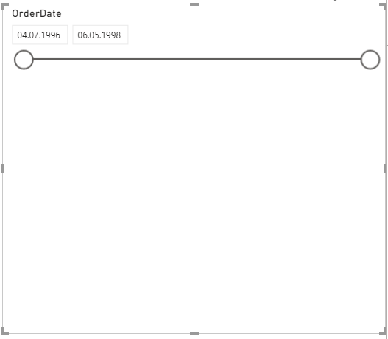
Slicers
Select Slicer Visual from Visualizations tab
Swipe OrderDate column from Orders table to Values column area
Right click on new OrderDate Column and remove Date hierarchy
Then, Click little drop down selection button which is located in the right top area of the slicer visual on canvas
Select Between
www.dsa.az Bütün hüquqlar qorunur.
DATA SCIENCE ACADEMY
16

Slide 17
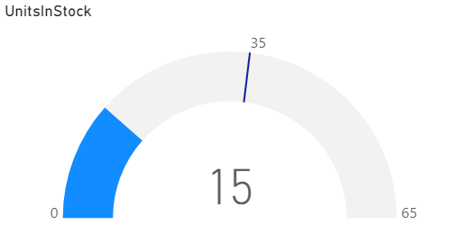
Gauge visual
Select Gauge Visual from Visualizations tab
Swipe UnitsInStock column from Products table to Value column area
Write Min:0,Max:65,Target:35 in the Gauge axis field in Format tab
Put ProductName column in Slicer part instead of OrderDate column
Then We can know which Products pass target in the stock.
FYI, Selection can be selected as Single or Multiple select from Selection controls in Format tab.
www.dsa.az Bütün hüquqlar qorunur.
DATA SCIENCE ACADEMY
17

Slide 18
III
Creating Dashboards

Slide 19
Interactivity of Visuals
Select any visual
Click Edit Interactions button in the new opened format tab which is located upwards
Emphasizes the effect of the selected visual with special lighting
Any element selected in the visual filters the other visual
Stops the effect of the selected visual
www.dsa.az Bütün hüquqlar qorunur.
DATA SCIENCE ACADEMY
19

Slide 20
Filters
dddd
Visual level filter – applies the filter only to the selected visual
Page level filter – applies a filter to all visuals on the page
Report level filter – applies a filter to all pages and all visuals
www.dsa.az Bütün hüquqlar qorunur.
DATA SCIENCE ACADEMY
20

Slide 21
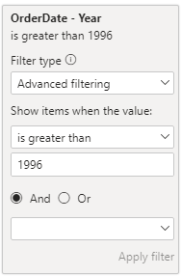
Visual level filter
Click Line Chart on the canvas
Open the Filters windows which is located in right tab
Select drop-down selection for OrderDate-Year part
Select and write Show items when the value is greater than, 1996
Click Apply Filter button
www.dsa.az Bütün hüquqlar qorunur.
DATA SCIENCE ACADEMY
21

Slide 22
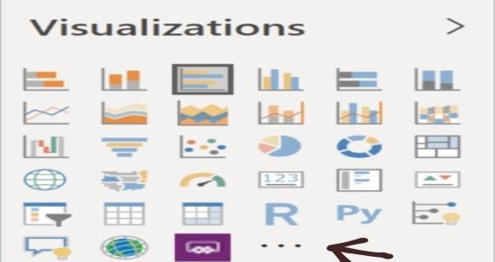
Power BI AppSource
In the Visualizations section, select "Get more Visuals." With this button, you will enter a new gallery where you can get applications from both your organization and the AppSource market.
Visuals which has verified button can be got with clicking Get it Now
Also, it can be filtered by any category and any filter
www.dsa.az Bütün hüquqlar qorunur.
DATA SCIENCE ACADEMY
22

Slide 23

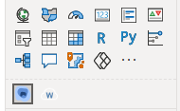
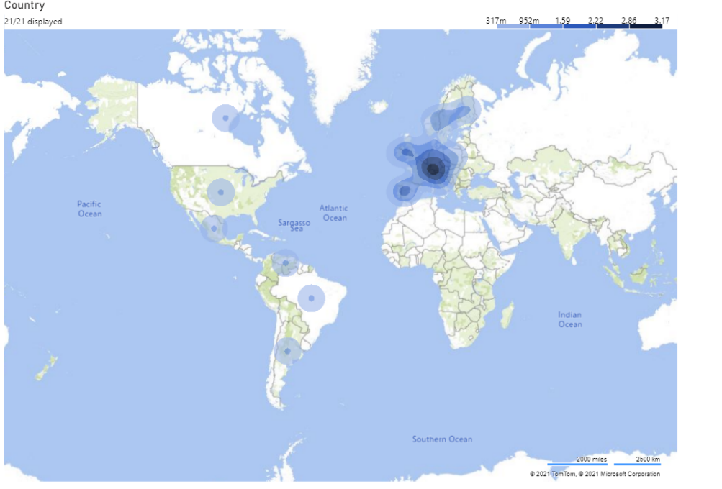
Additional Visuals
Click three dots from Visualizations tab
Search “Heat Map” and add it
Select Heat Map icon from Visualizations tab and add Countries as LocationID.
www.dsa.az Bütün hüquqlar qorunur.
DATA SCIENCE ACADEMY
23

Slide 24
Thank you!

